Slide 1

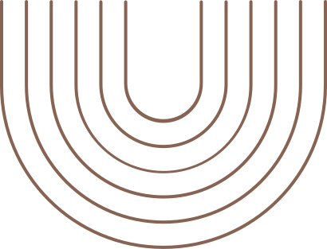

python
final project

Slide 2
Introduction
-Analyzing the Effects of Music Therapy on Prefrontal Alpha Band Power: A Comparative Study of Pre- and Post-Task EEG Activity.
-Research question :
How does pre-task brain activity differ from post-task brain activity during music-listening sessions in patients, focusing on alpha band power in the prefrontal region?
.

Slide 3
Background
Relaxation is perceptible in EEG as increased alpha frequency (8-13 Hz), in the prefrontal regions(Fp1,Fp2 channels) which are associated with calm and focused states

Slide 4
Process
1.
Collecting data
2.
Relevant libraries
3.
Coding... :)

Slide 5
Result
The analysis exposed a significant change in alpha power between pre and post-music therapy phases. The T-statistic was -2.38, and the P-value was 0.031(Figure 2), which indicates that the difference in alpha power between the phases is statistically significant at the 0.05 level.

Slide 6
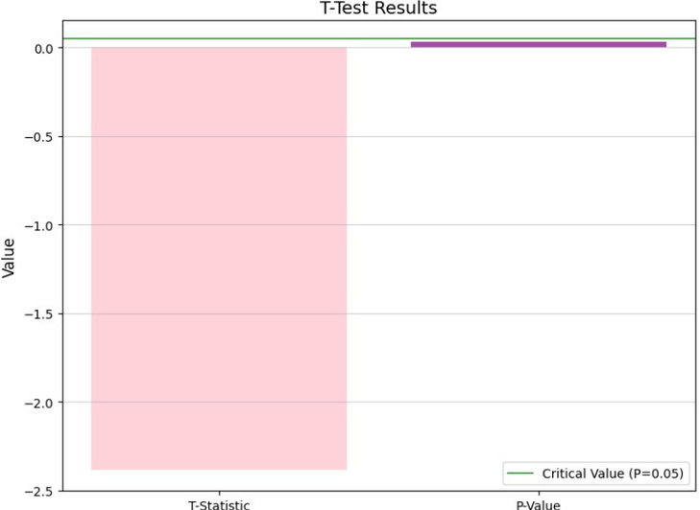
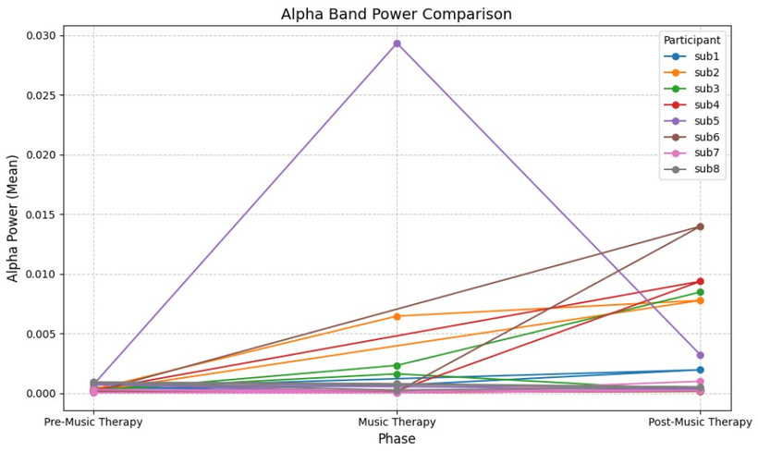
Conclusion
These results suggest that listening to music might increase relaxation, as reflected in the changes in alpha power, although individual variations were present

